Slide 1

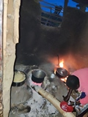
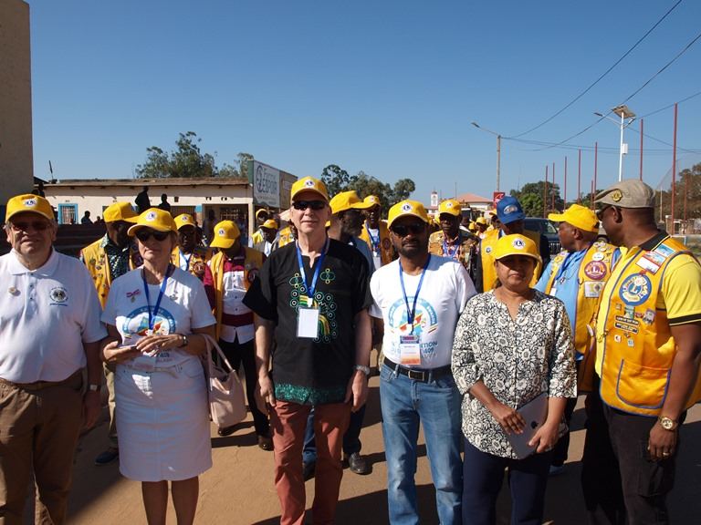
4thLions Euro Africa Webinar
Euro Africa Committee
History – Work – Objectives

Slide 2
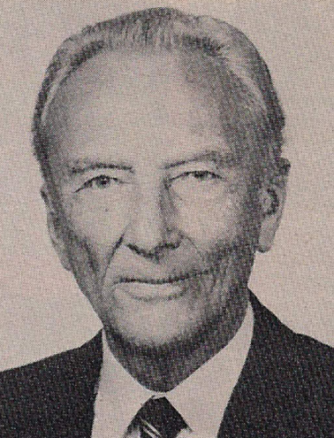
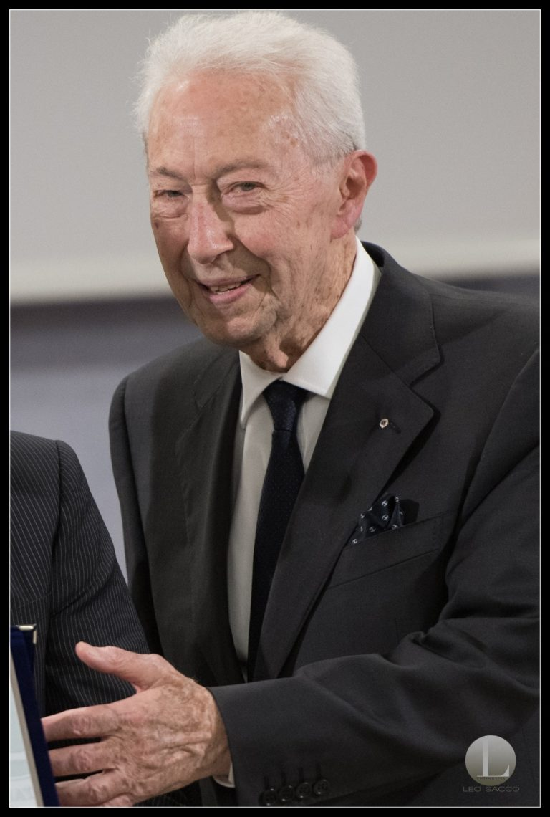
History:
PIP George Friedrichs MD 103, PIP Pino Grimaldi MD 108
1975/76 (6 members, only Europeans)
Objectives:
To enhance cultural and youth exchange
To support common service actions
To foster a better mutual understanding and friendship
4thLions Euro Africa Webinar

Slide 3

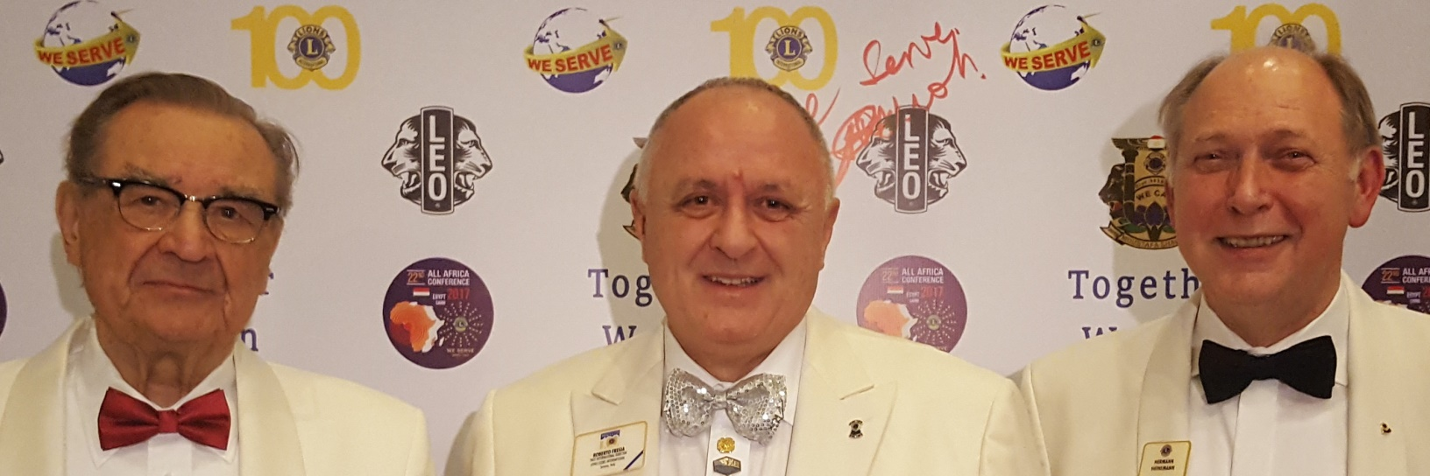
2006 Board:
Chairperson: Roberto Fresia MD 108
Co-Chair: Dr. Manoj Shah MD 411
Vice Chair: PDG Xavier de Franssu MD 103
Secretary: Claudia Balduzzi MD 108
4thLions Euro Africa Webinar

Slide 4
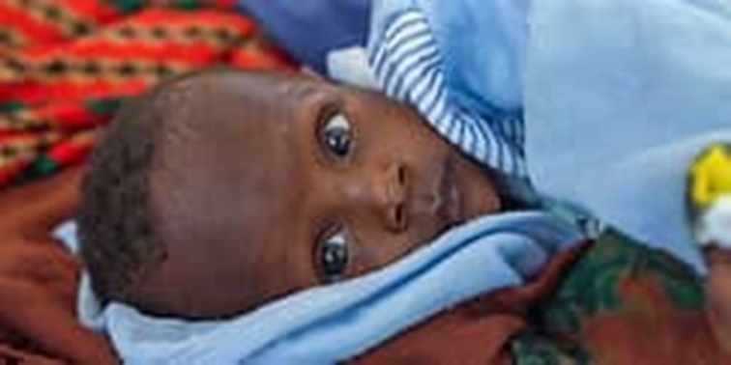
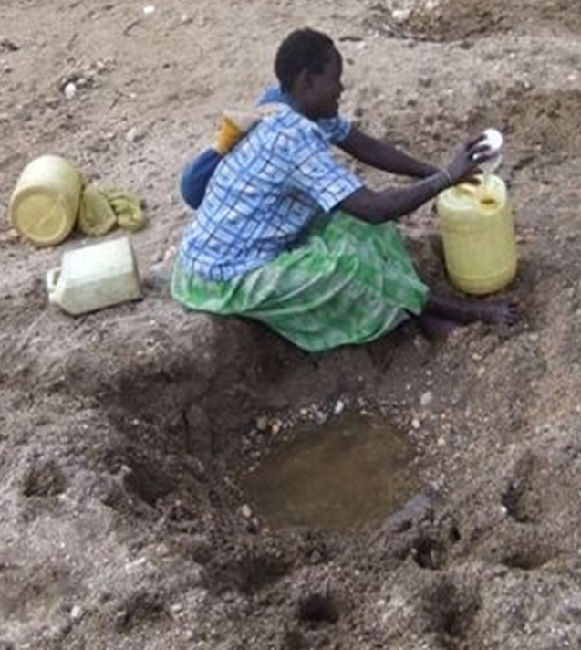
2006 First African members
2017/18 Rulesof procedure, targets:
To foster mutual contact, exchange of information and understanding… especially between the Lions of both continents
To foster a big common effort … to improve the situation of the poor population in Africa
4thLions Euro Africa Webinar

Slide 5
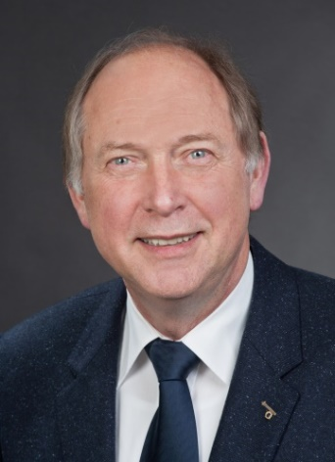
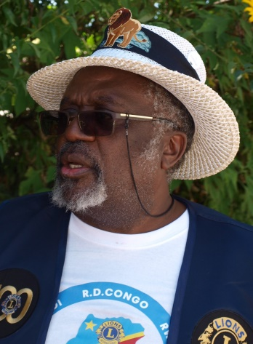
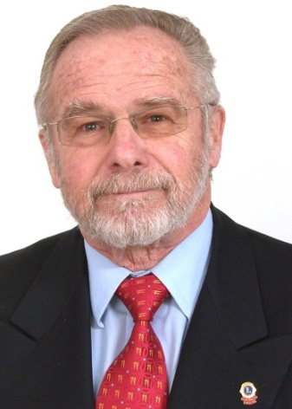
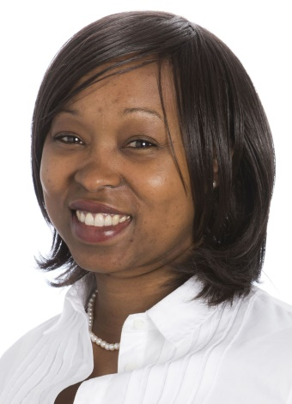
2018 Board:
Chair: PDG Hermann Heinemann MD 111
Co-Chair: PDG Mahina César Kalukuta MD 409
Vice Chair: PDG Beno Israel MD 111
Secretary: L Rita Bella Ada MD 111
4thLions Euro Africa Webinar

Slide 6
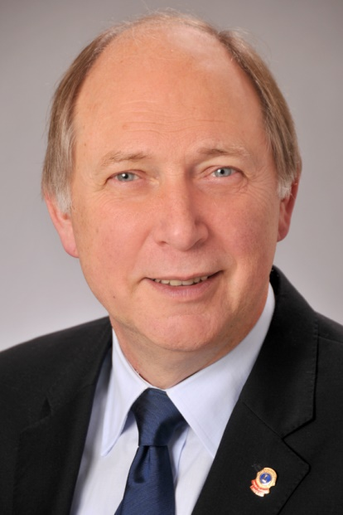
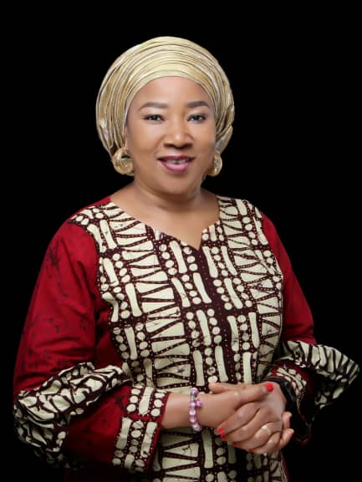
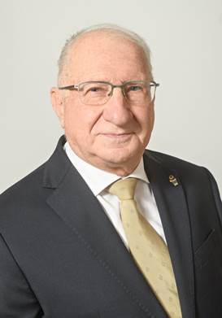
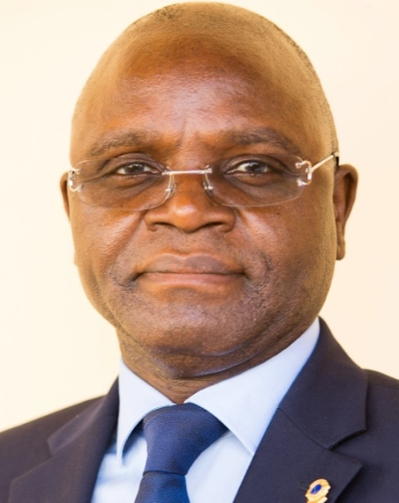
2021 Board:
Chair: PDG Hermann Heinemann MD 111
Co-Chair: PCC Dr Lami Ahmed MD 404
Vice Chair: PDG Dr Franco Marchesani MD 108
Secretary: PDG Dr Mbadinga Itsouhou MD 403
4thLions Euro Africa Webinar

Slide 7
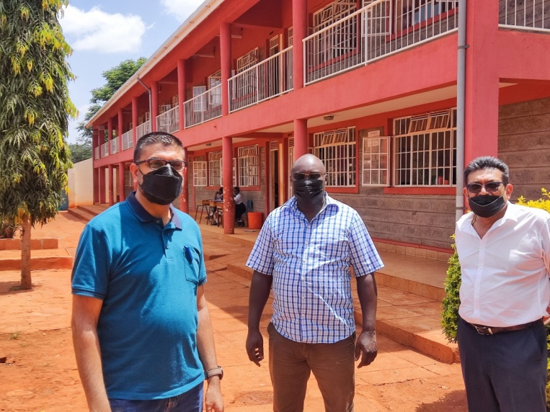
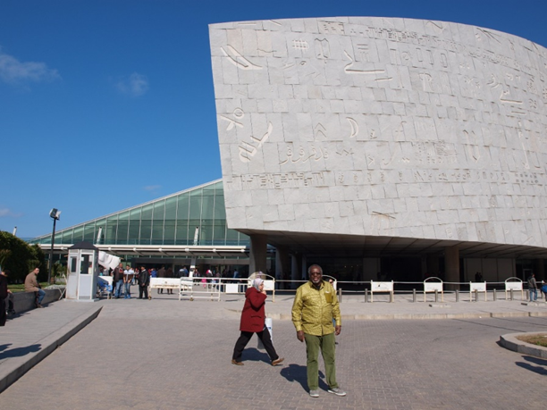
Situation in 2018:
Standing Committee for Europa Forum and Africa Forum
No power – No money
Mailing List: 23 persons
Still unknown to many Lions in Africa and Europe
How to get more impact?
4thLions Euro Africa Webinar

Slide 8
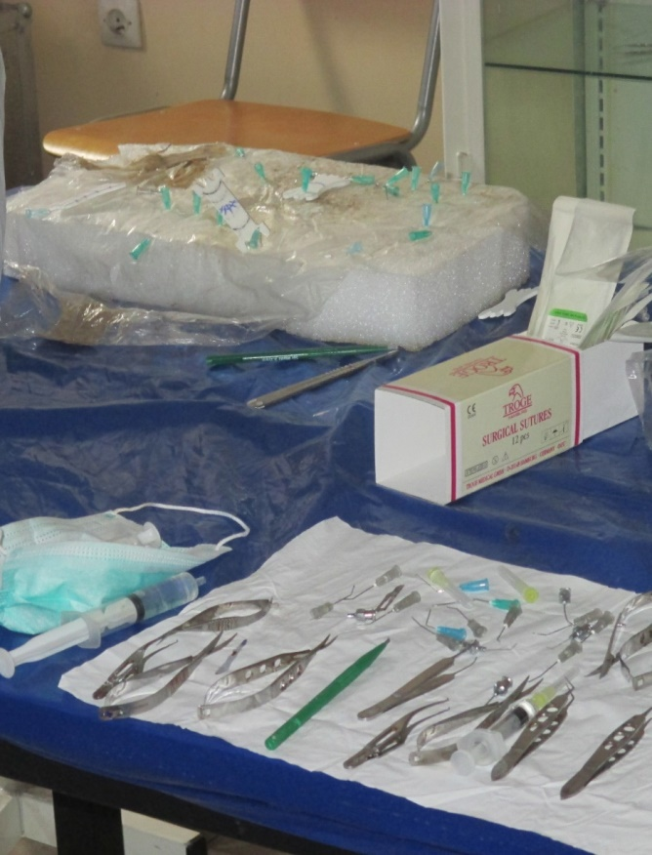
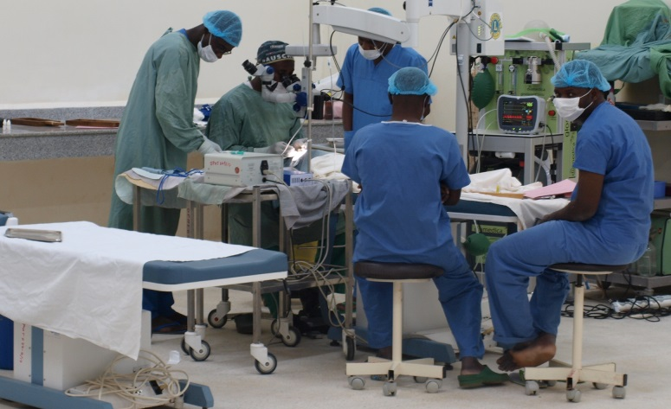
To know and to become known
To get more delegates, members and Interested persons
To make more contacts
Discuss about the quality, sustainability and effective ness of projects
Become an expert and advisor
4thLions Euro Africa Webinar

Slide 9
Connaître et devenir connu
Obtenir plus de délégués, de membres et de personnes intéressées
Établir davantage de contacts
Discuter de la qualité, de la durabilité et de l'efficacité des projets
Devenir un expert et un conseiller
4thLions Euro Africa Webinar

Slide 10
What we did up to now:
Open Meeting and Closed meeting at every Africa Forum and Europa Forum since 2018 (2013) – 12 Forums / 24 meetings, in addition:
Newsletter since 2018: 9 releases in English and French
Articles in German Lion Magazine
Addresse and speeches in Africa Forum and Europa Forum, District Conventions, Clubs, Council meetings
Visit to DRC (2019), Tunisia(2019) and Kenya (2019, 2022) for District Conventions, MD-Conventions, visit to projects
4thLions Euro Africa Webinar

Slide 11
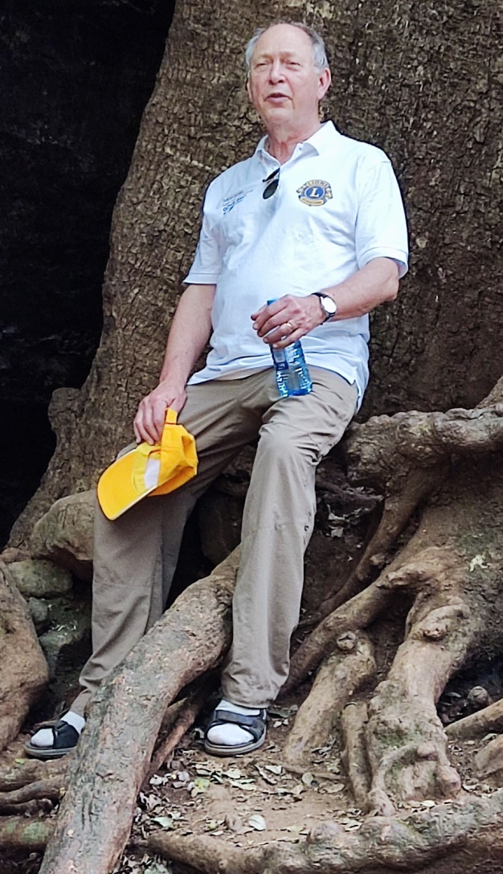
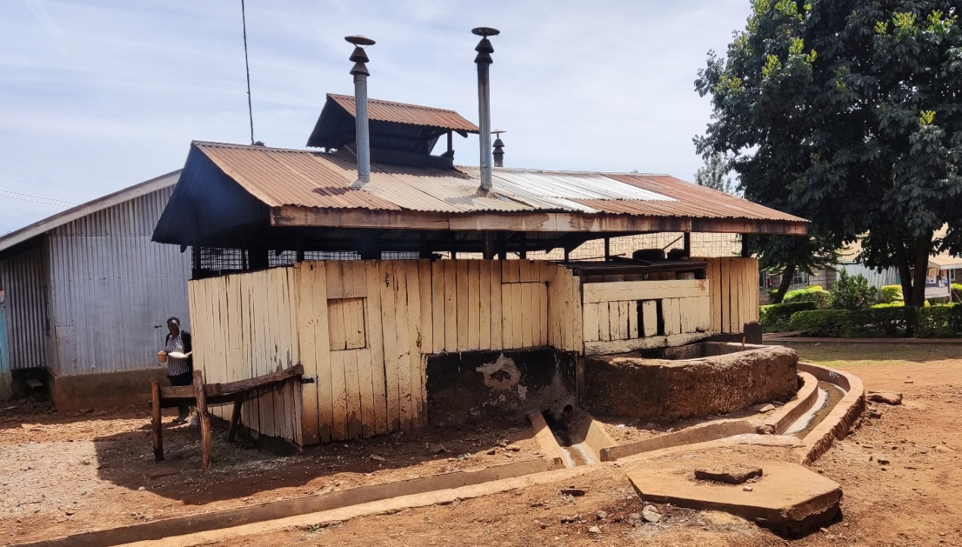
Participation online:
European Lions Virtual Symposium 2020
AFRICA LIONS SUMMIT 2021
DM 103 FRANCE Convention Virtuelle
2ND AFRICA FORUM 2021
4thLions Euro Africa Webinar

Slide 12
Own Online Events:
Open Online Meetings: May 2021, Sep 2022
Online Board Election 2021
Euro Africa Webinars (each more than 100 pafrticipants) : 2022, 2023, 2024
Own Website
... In addition
3 Online Board Meetings with African Leadership
24 Online Board Meeings since 2021
Speeches at Meetings of MDs, districts, clubs
More than 20 ppt-presentations
4thLions Euro Africa Webinar

Slide 13
The results:
Feb 2019: 15 delegates, 8 members. Total mailing list: 23
Dec 2023: 38 Delegates and Members, 64 interested persons: total mailing list: 102
More and more participants in EF and AF, in AF also in Seminars and Plenary Sessions
Lions Re-Greening Africa Campaign startet upon initiative of Euro Africa Committee
4thLions Euro Africa Webinar

Slide 14
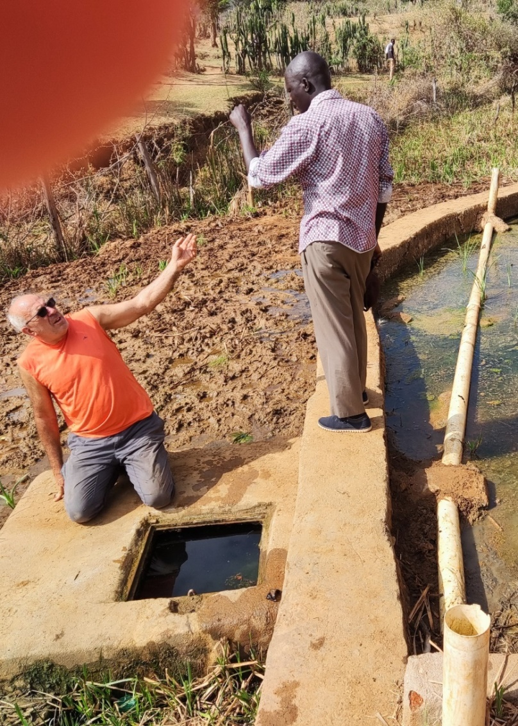
And now we ask you:
Was it successful?
Shall/Must we continue the same acitivities?
How can we get more impact?
Which can be the role of the committee at financing projects?
4thLions Euro Africa Webinar

Slide 15
How Lions projects are financed?
Donations from single persons or companies
Collection by a one or more club, a district, MD
Grants from Foundations, private, Lions, LCIF
Grants from Companies
Grants or Contributions from Authorities
In general Lions projects depend on private money
4thLions Euro Africa Webinar

Slide 16
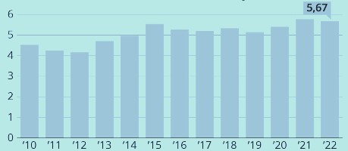
Can we increase private donations?
Long term development in European countries (per year)
Germany: 5 billion
Great Britain: 13.5 billion
France: 2.8 billion
76.3% Humanitarian help
7.4% Animals
3.4% Environment, Nature
12.9% Others
No substantial Growth since years
Special need (Ucraine) means loss for other purposes
German Lions in total about 30Mill
We have no chance!
4thLions Euro Africa Webinar

Slide 17
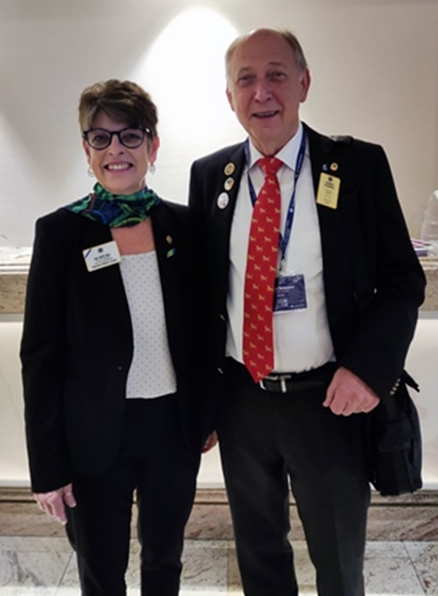
Global Challenge for 21st Century
Climate change alarms the whole world
2021 France: 12 billion for Great Green Wall
Other European countries follow with billions
EU ReGreening Africa to reverse degradation on 1 mill ha
Lions should be partner of Re-Greening Africa!
4thLions Euro Africa Webinar

Slide 18
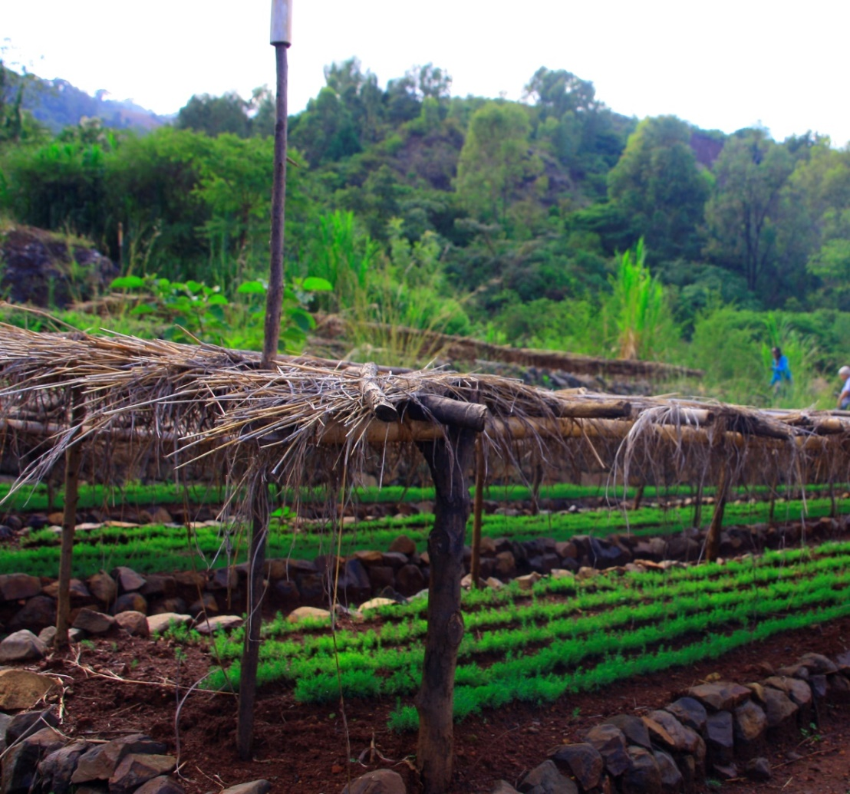
The idea…
Proof of African Lions' expertise in these five pilot projects
Planning new projects
Create a large movement with various European partners
How to implement it?
4thLions Euro Africa Webinar

Slide 19
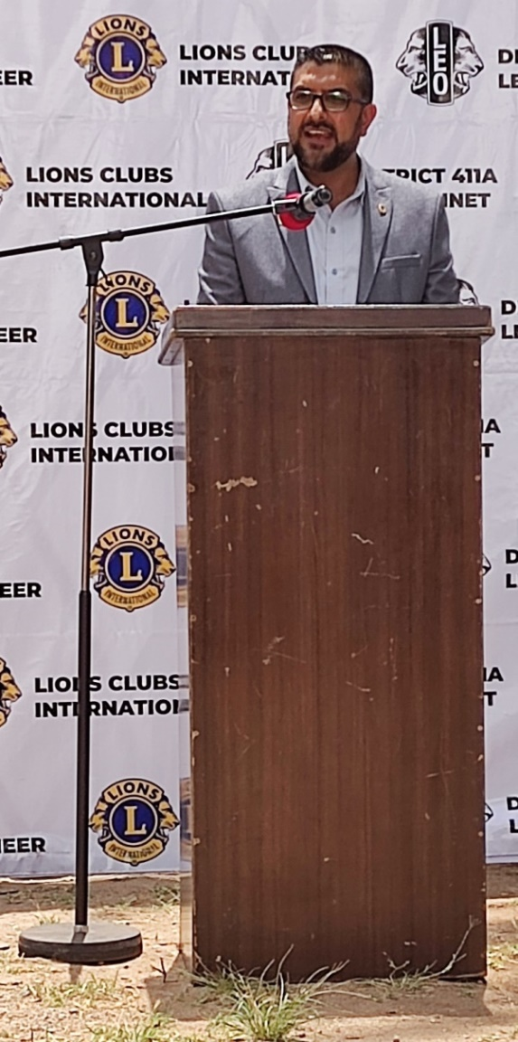
What shall we do?
Convince and motivate the local population
Create networks between locals, experts, Lions and authorities
Involve many volunteers to convince national and European authorities
Convince more and more NGOs to do the same
4thLions Euro Africa Webinar

Slide 20
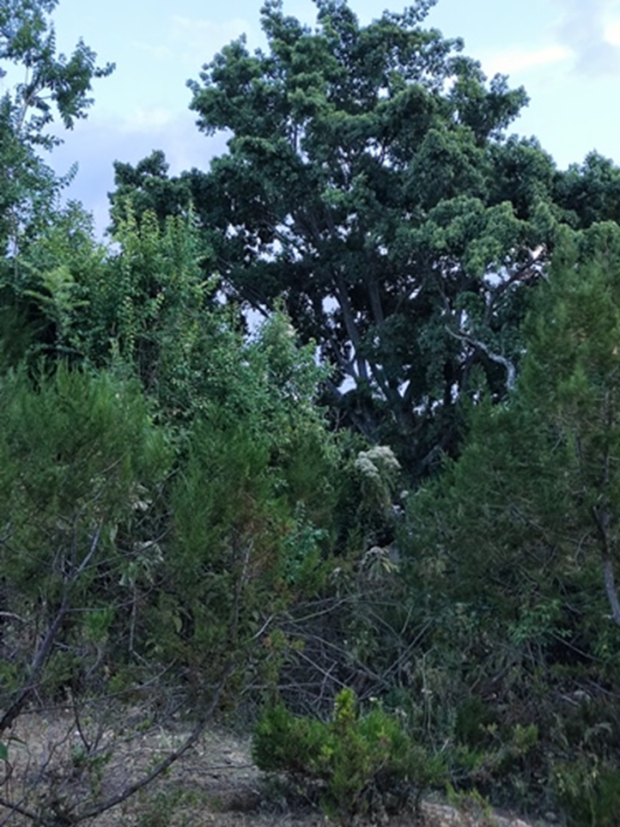
THERE IS HOPE!
We know …
We need many active volunteers
It is not the solution for all problems
Most important is the human factor
We will make mistakes
But …
4thLions Euro Africa Webinar

