Slide 1

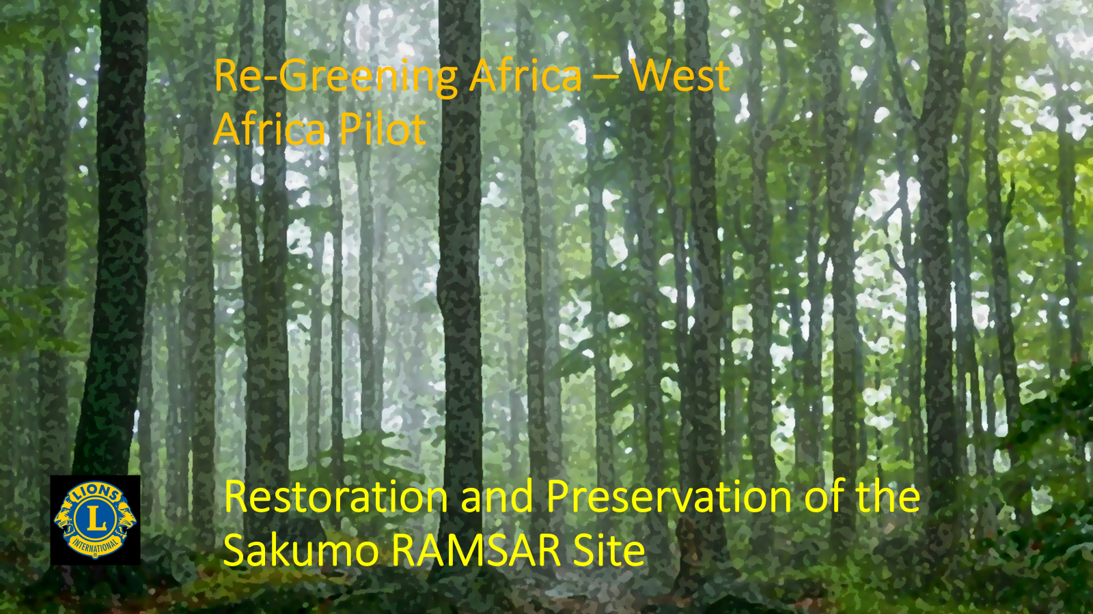
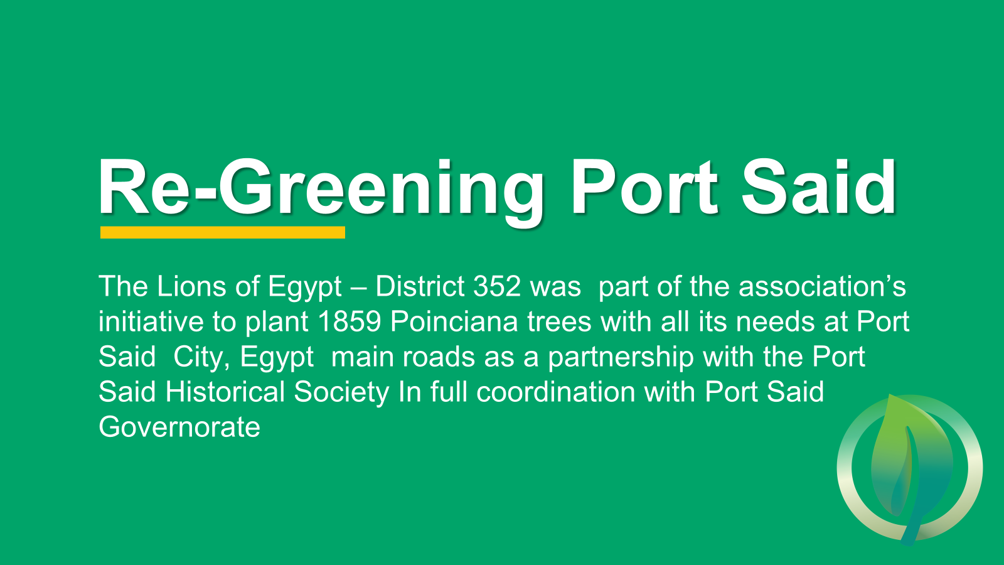
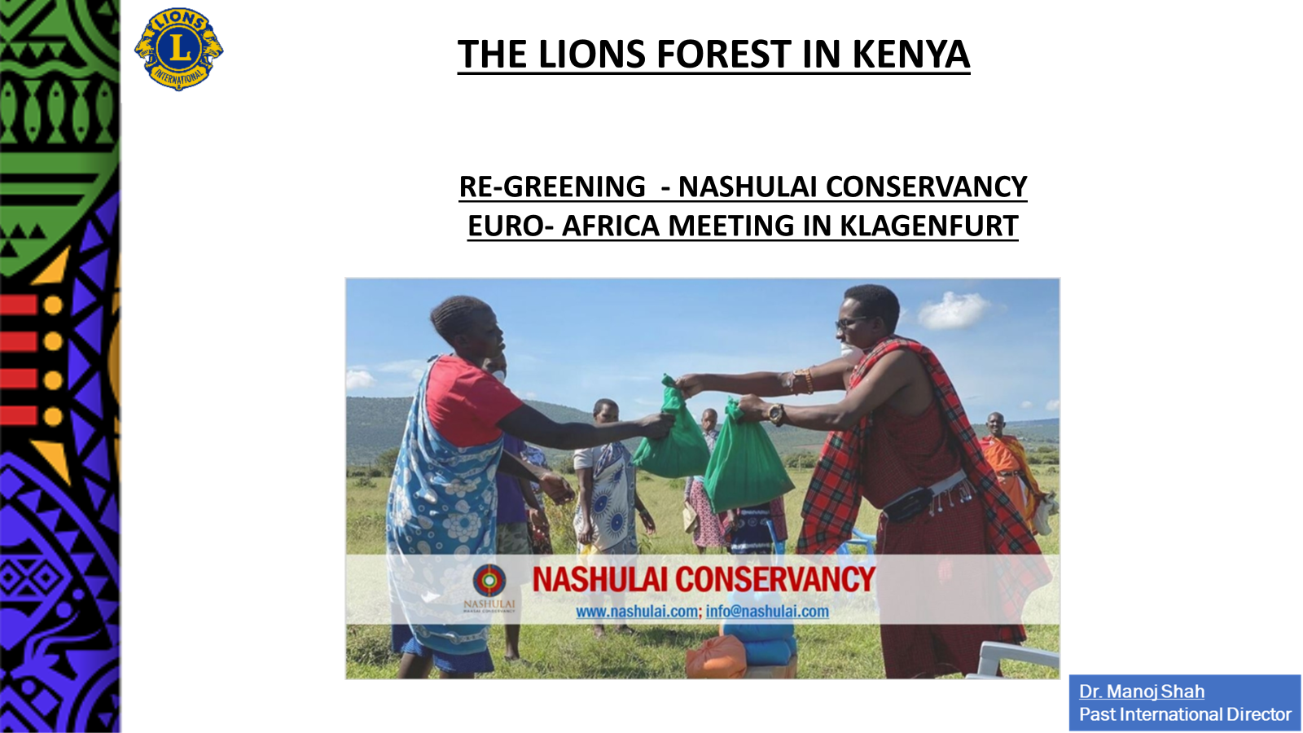

Africa Regreening Pilot projects

Slide 2
Projects Key caracteristics
 | Domain | Local Community involvement | GHG Impact | Value | Financement | Local authorities | Local Lions action
Ouagadougou green belt rehabilitation | Planting of 8.000 trees and agricultural activities | Beneficiaries associated to the initiave | decrease of GHG | Euros 312 K | Local and external parternship | Ouagadougou Municipality | Porject supported by LC Ouagadougou Karite
Nashulai Conservancy Kenya | Tree planting, increase of water resources, help in human – wilde life conflit | Masai Mara community associated to the initiative | decrease of GHG |  | Local and external parternship |  | Kenya Lions
Nalusanga – Zambia | Reforestation and use of natural resource | Agricultural community groups associated implementation (Chiefdoms) | decrease of GHG | USD 428 K | Local and external partnership |  | Coordination and Fundraising

Slide 3
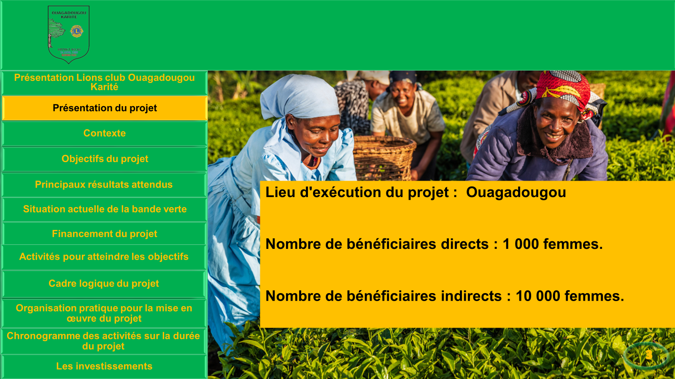
OUAGADOUGOU GREEN BELT – BURKINA FASO

Slide 4
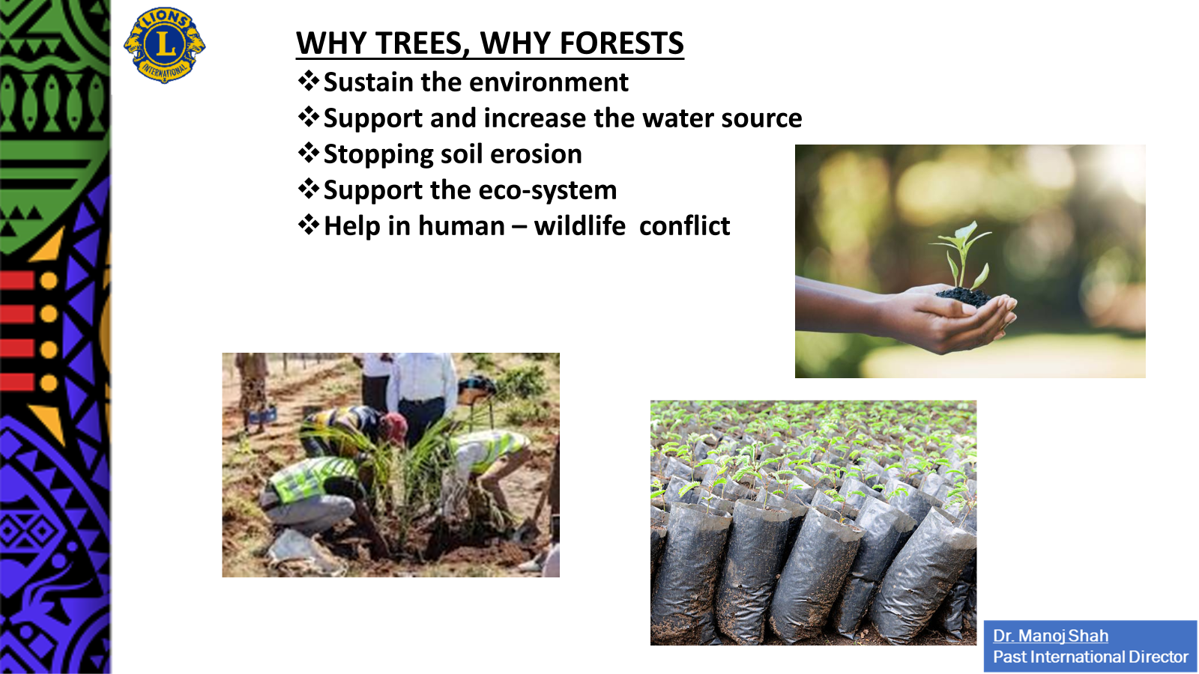
NASHULAI PROJECT KENYA

Slide 5
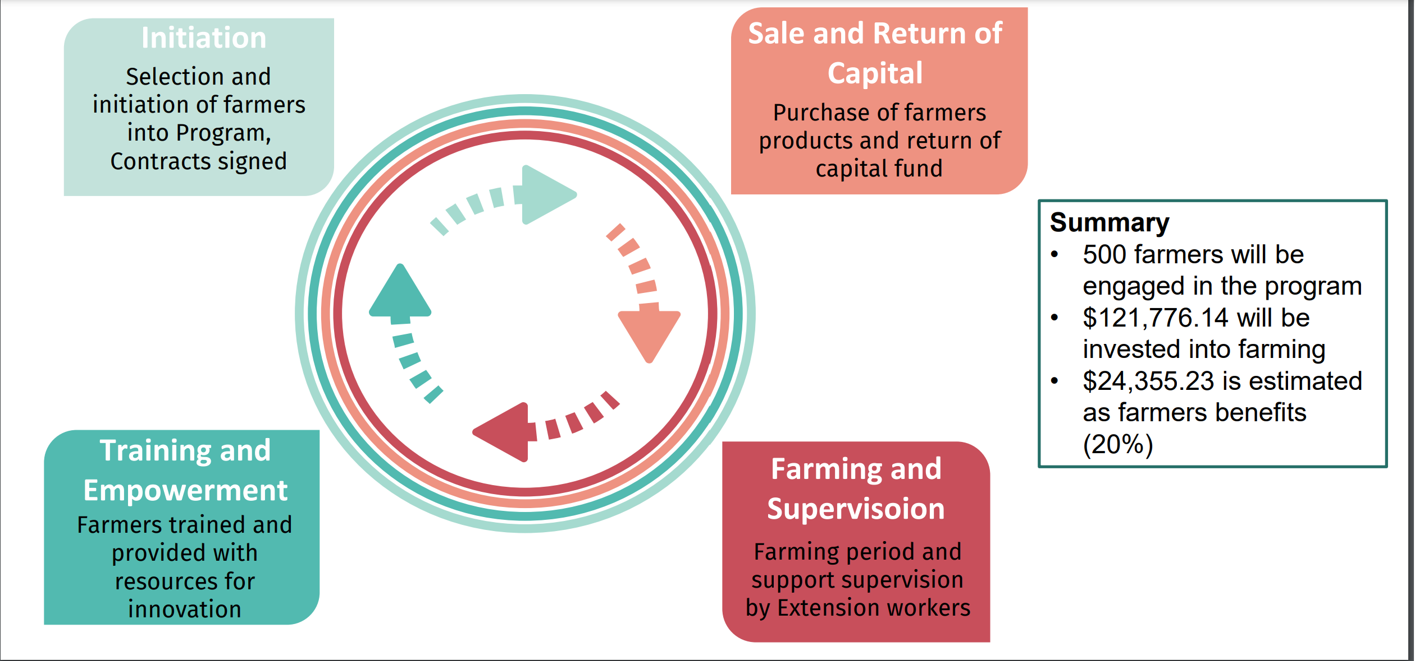
NALUSANGA PROJECT ZAMBIA

Slide 6
Projects Key caracteristics
 | Domain | Local Community involvement | GHG Impact | Value | Financement | Local authorities | Local Lions action
Port Said Regreening | Tree planting (1859) | Port Said Historical Society | decrease of GHG |  | Local | Port Said Governorate | D 352 Lions
Ramsar Project | Tree planting and site rehabilitation | Chiefs, opinion leaders, youth and fisher folks | decrease of GHG | USD 200 K | Local and external | Governement involved | District 418

Slide 7

PORT SAID POICIANA PROJECT

Slide 8
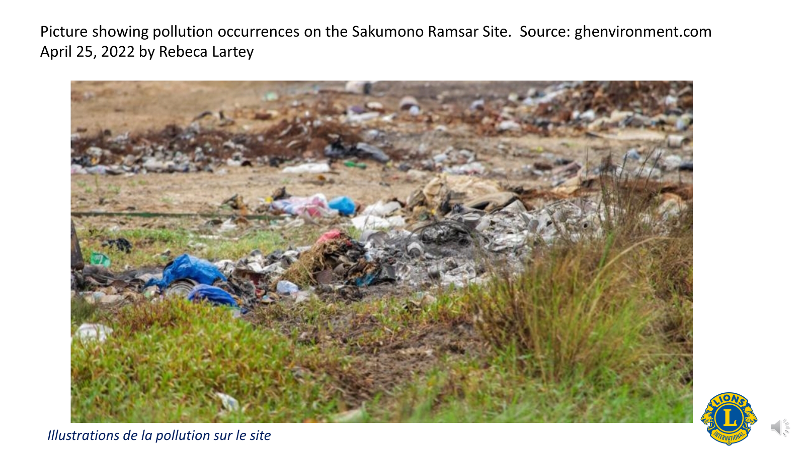
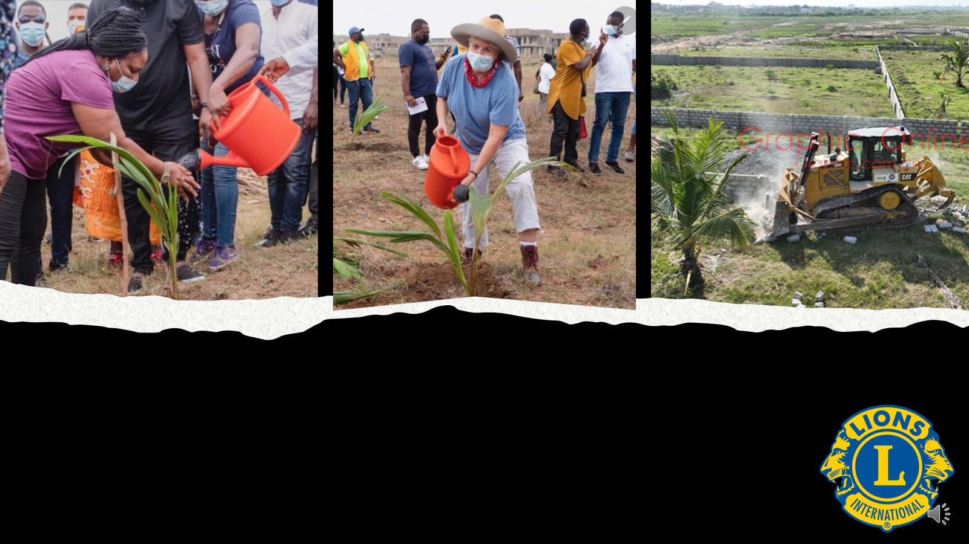
SAKUMUNA RAMSAR - GHANA

Slide 9
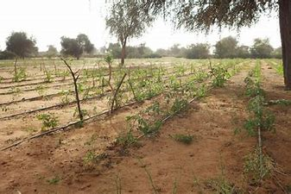
Merci – Thank you

